Slide 1
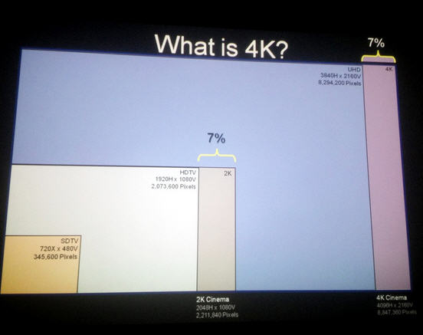
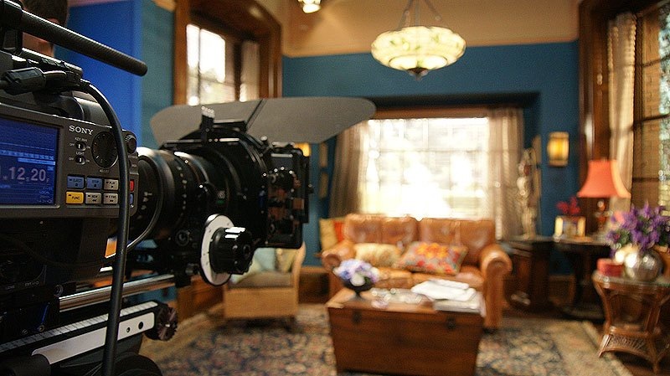
4K TV LA Press Trip Initial SOCAN Media Impressions with Future Shop via Digital Journal
Prepared by Christina Stefanski
Public Relations Specialist
May 3, 2013

Slide 2
Media/Social Media Impressions
Digital Journal directed & recorded video on behalf of Sony Canada working with Brent de Waal, Future Shop’s Elliott Chun and Tech Journalist Carl-Edwin Michel
Initial media impressions via Future Shop Tech Blog and YouTube channels: +2.5 million
Sony 4K article/video with Carl-Edwin Michel on Canoe.ca (9.5 million impressions)
Initial social media impressions via @SonyCanadanews and @sony_canada + #4KTV hashtag: +2 million
Sony Canada Facebook (90K followers) + Future Shop Facebook shared “The Sony 4K Experience” photo album (500K followers)
Twitter schedule will go live next week to share 4K story with key 4K TV audiences: film makers, audio early-adopters, gamers, and TV fans, and Canadian media alongside 55/65” 4K TV launch in national Sony Stores

Slide 3
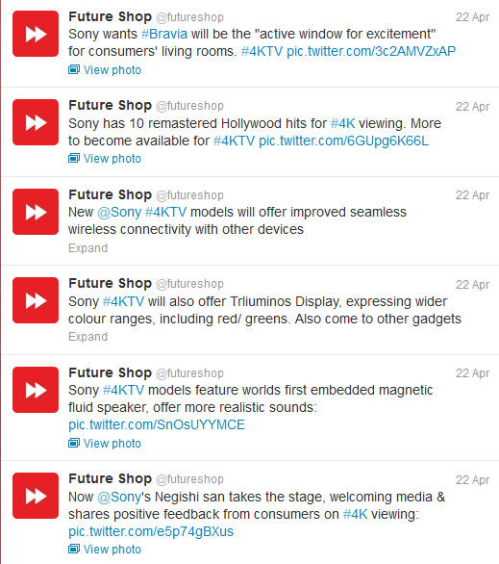
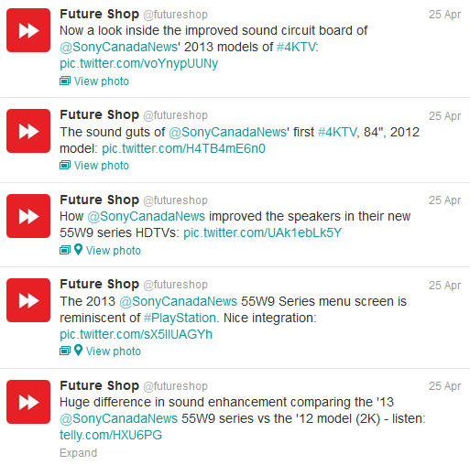

Slide 4
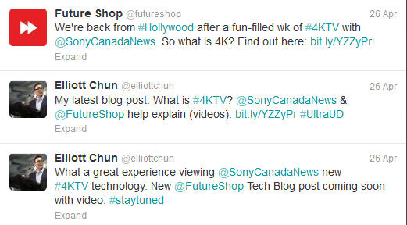
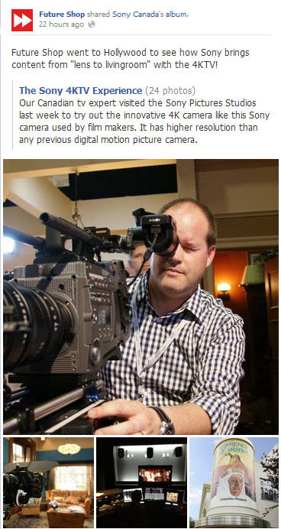
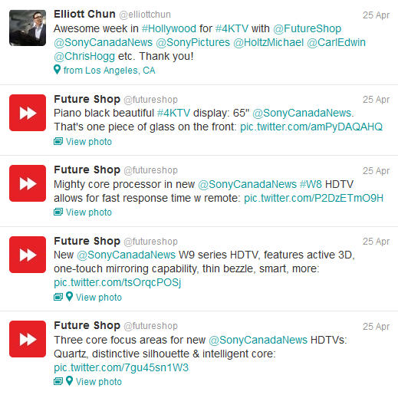
500K followers

Slide 5
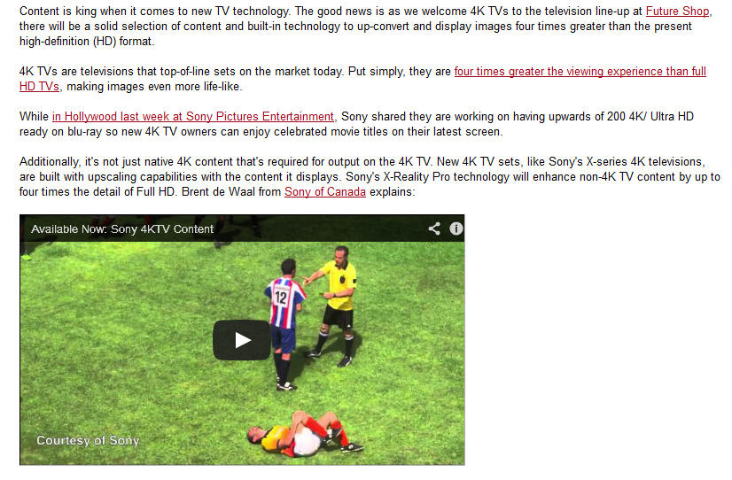
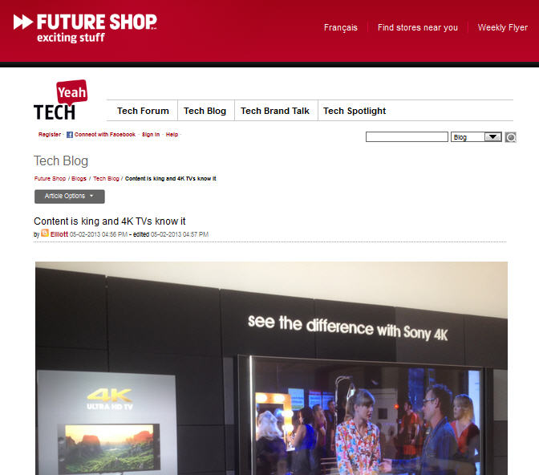
Impressions: 500,000

Slide 6
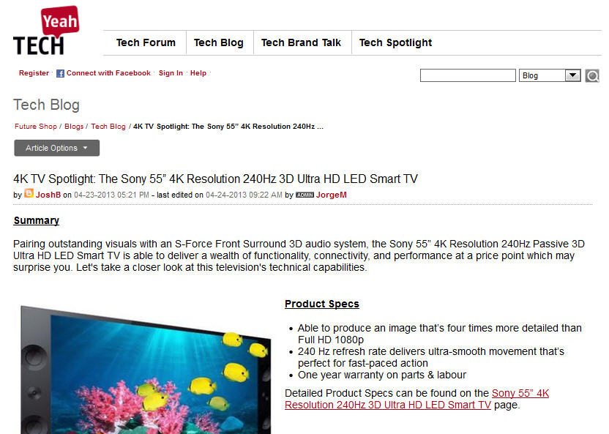
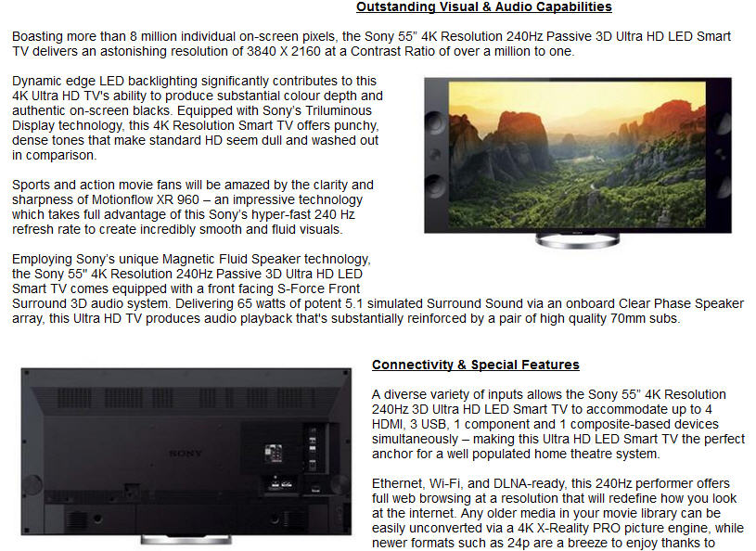
Impressions: 500,000

Slide 7
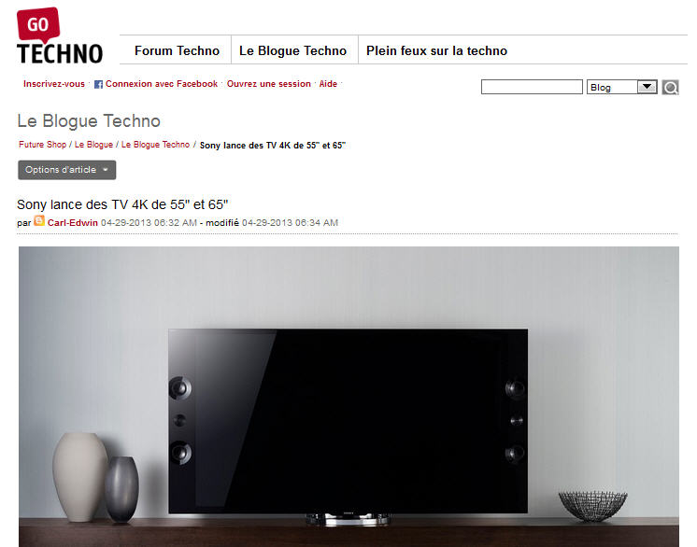
Impressions: 500,000

Slide 8
Impressions: 9.5M

Slide 9
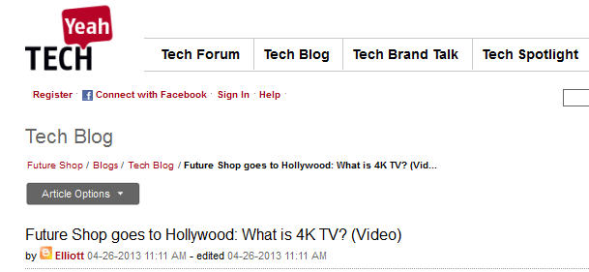
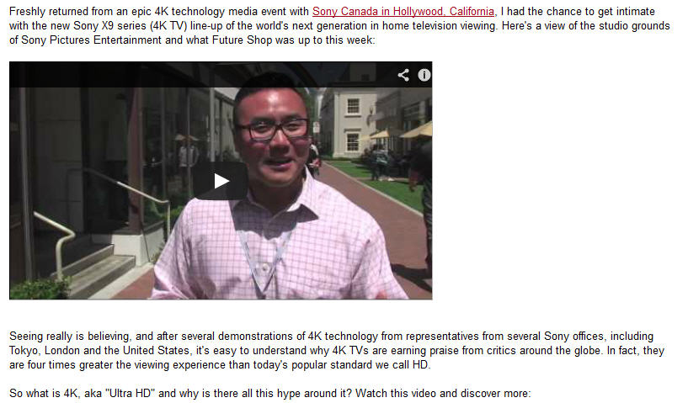
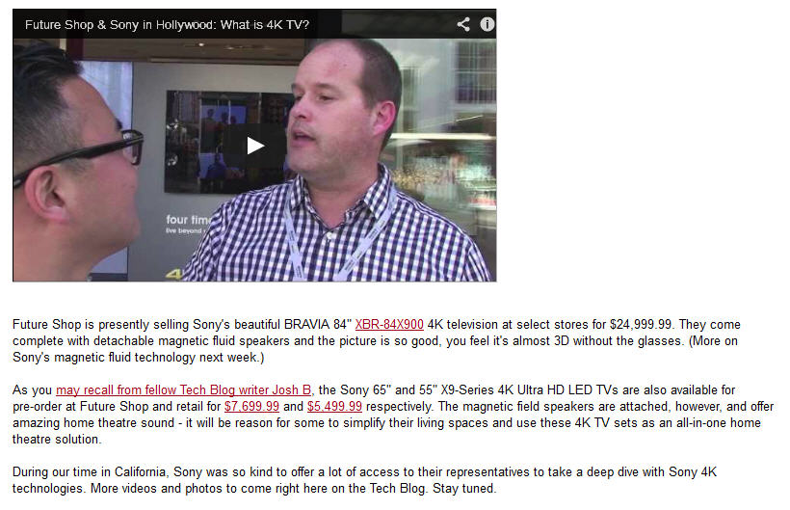
Impressions: 500,000
This article links to store.sony.ca

Slide 10
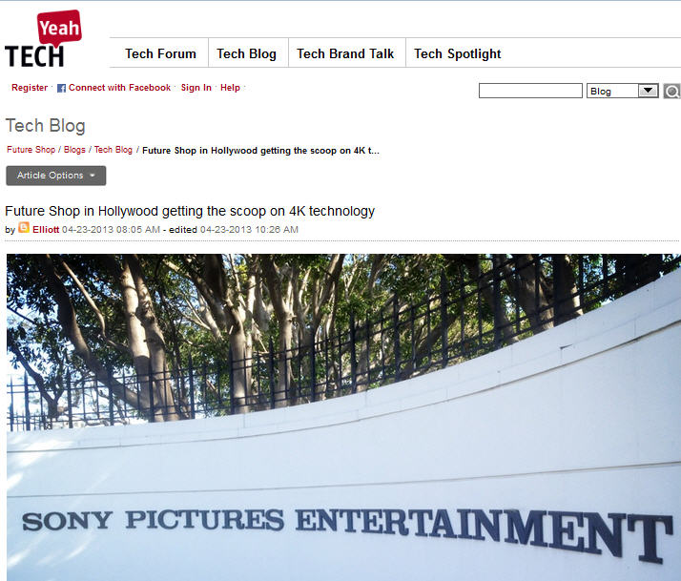
Impressions: 500,000
Elliott Chun, Communications Manager, Future Shop with
Tech Journalist Carl-Edwin Michel

Slide 11
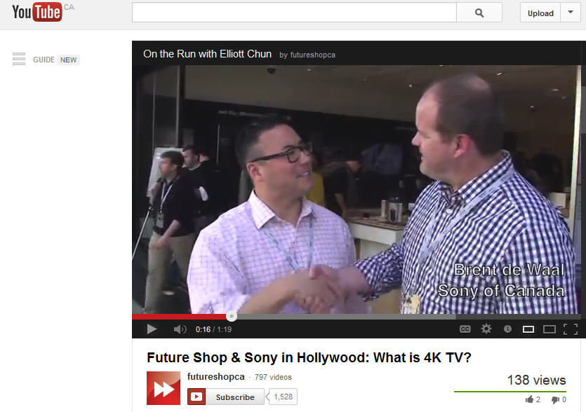

Slide 12
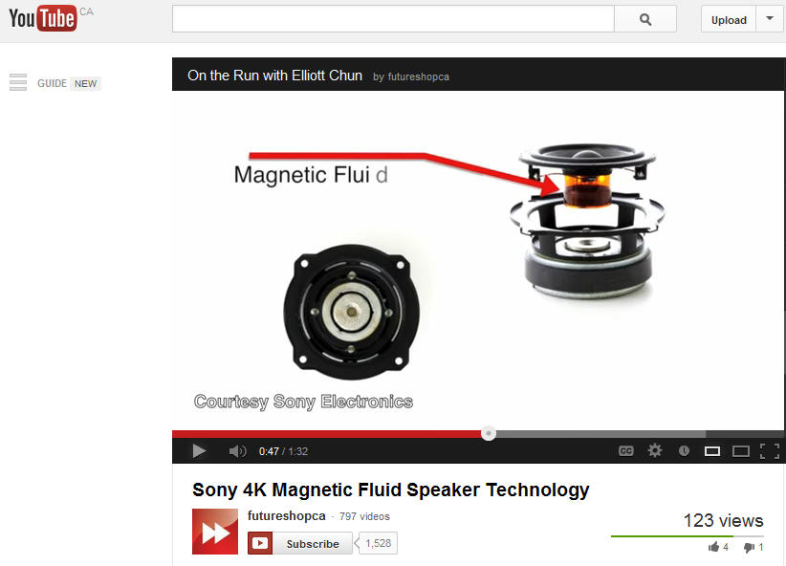

Slide 13
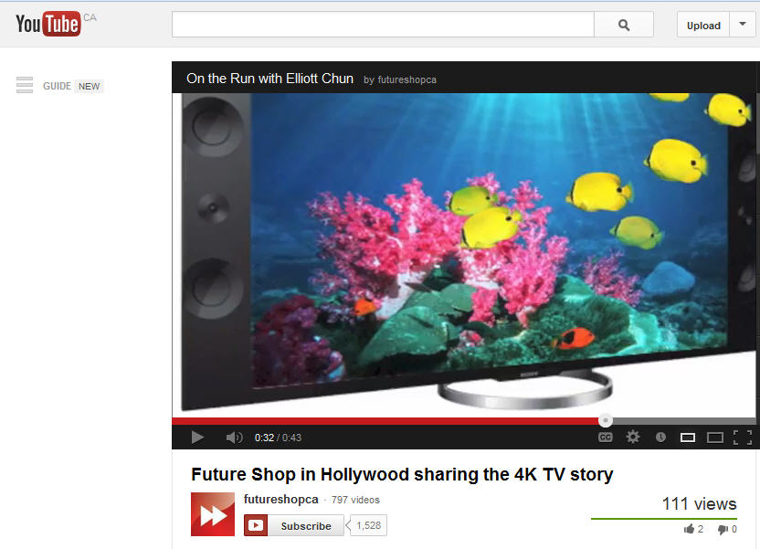

Slide 14
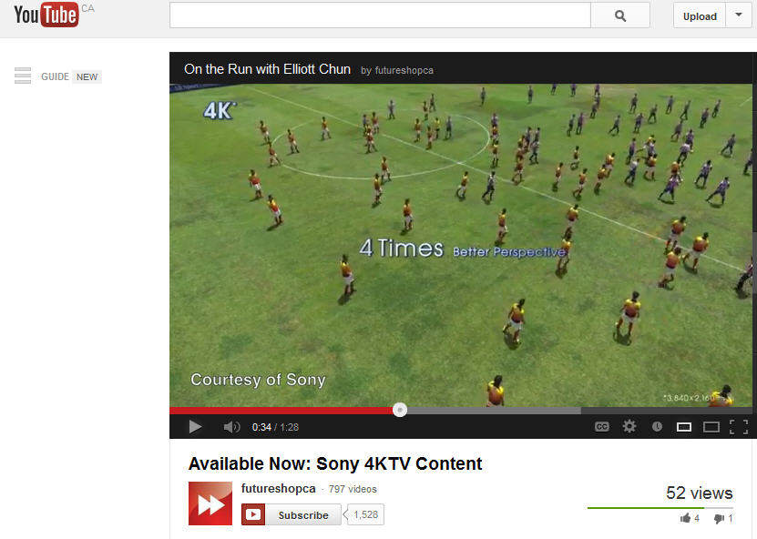

Slide 15
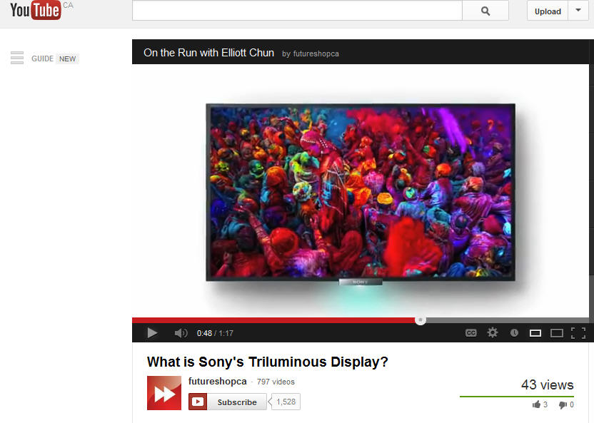

Slide 17
The new standard within a few years?
The news follows a Sony briefing on April 23 where the company -- which has invested heavily in the UHD format as a filmmaker, broadcaster and TV manufacturer -- claimed the technology is being adopted at a much faster rate than even it had predicted. Talking to Pocket Lint, Chris Cookson, president of technology at Sony Pictures said: "I've always felt that there was an inevitability that screen resolution would increase and that the size of the image that people seek out will get bigger and that, as it gets bigger, 2K (1080p) isn't quite enough," he added. "I would have guessed [that would happen] a couple of years from now. But, if you look at where we are, we are ahead of that.”

