Slide 1
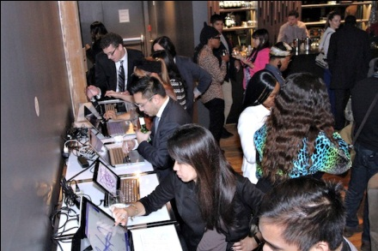
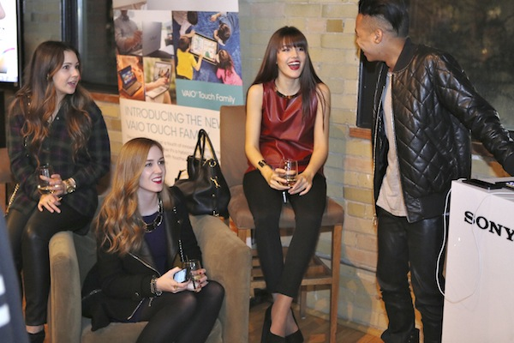
SOCAN VAIO Touch Influencer Campaign
Dec. 17, 2012 Event + 2013 Product Reviews/Contests

Slide 2
Total VAIO Touch Campaign Reach of 5 Influencers
Total Blog reach: +727,000 impressions
Total Twitter reach: +2,060,000 impressions
Total Instagram reach: +34,600 impressions
Total Google+ reach: +30,000 impressions
Total Facebook reach: +9,500 impressions
TOTAL REACH: +2,861,100 impressions

Slide 3
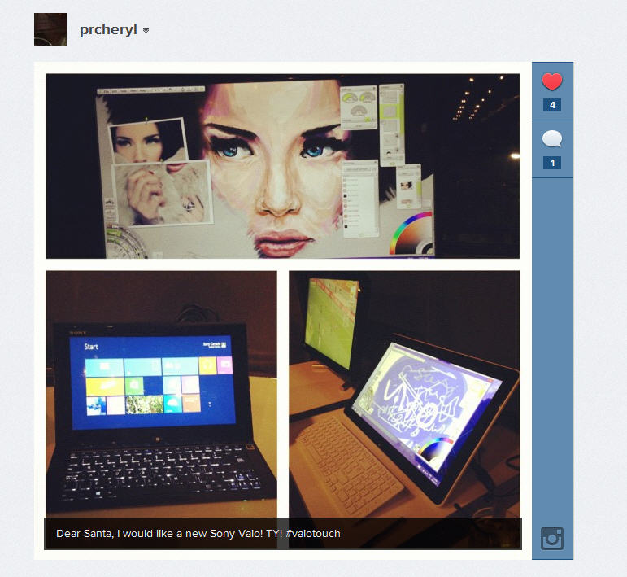
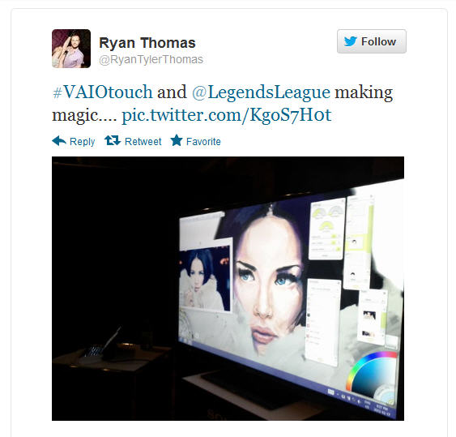
Social Media Impressions on Dec. 17
#VAIOTOUCH achieved trending status in Toronto, reaching +2 million impressions in 24 hours
Influencers and event attendees
shared VAIO Touch photos on
Instagram, Facebook, and Twitter
across over 100K followers

Slide 4
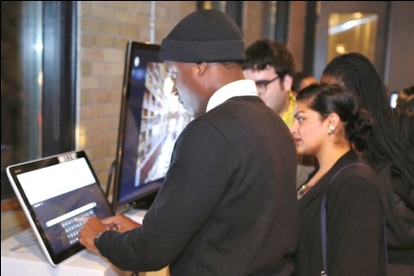
VAIO Touch Influencers engaging over 150 guests

Slide 5
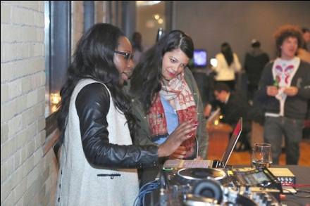
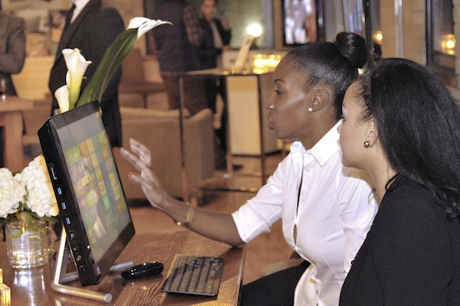
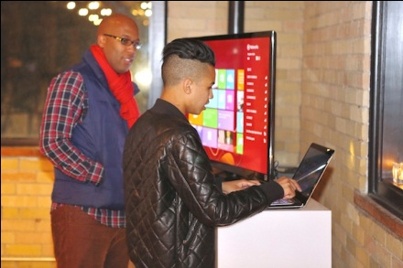
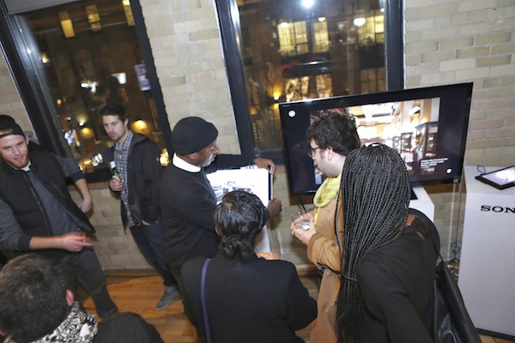
VAIO Touch Influencers educating guests on VAIO Touch features

Slide 6
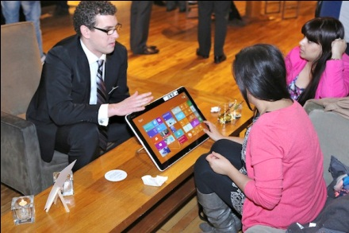
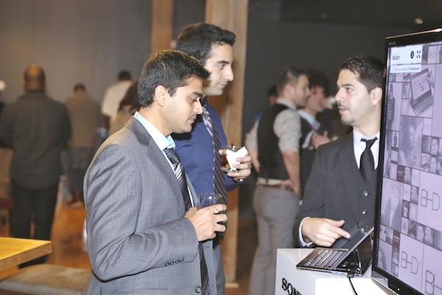
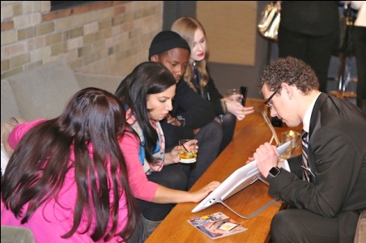
SOCAN team engaging guests

Slide 7
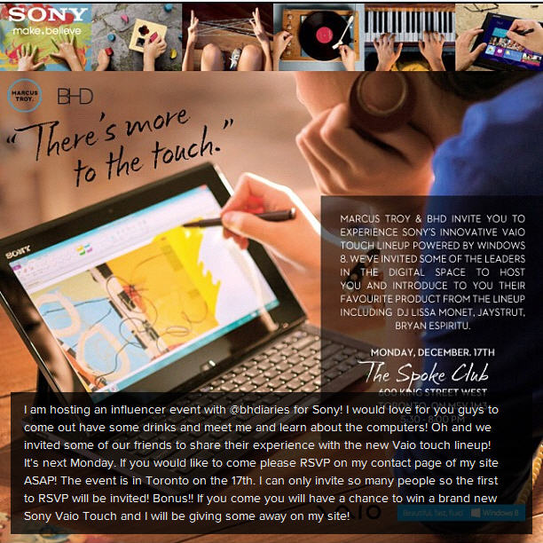
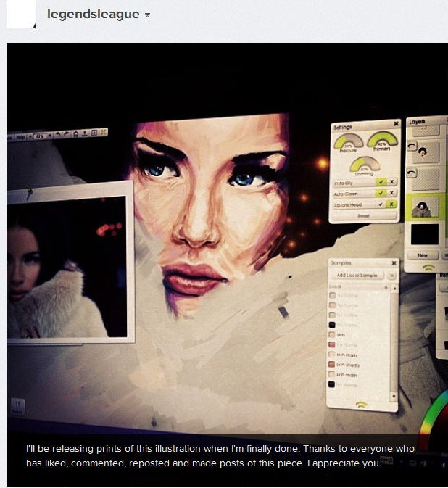
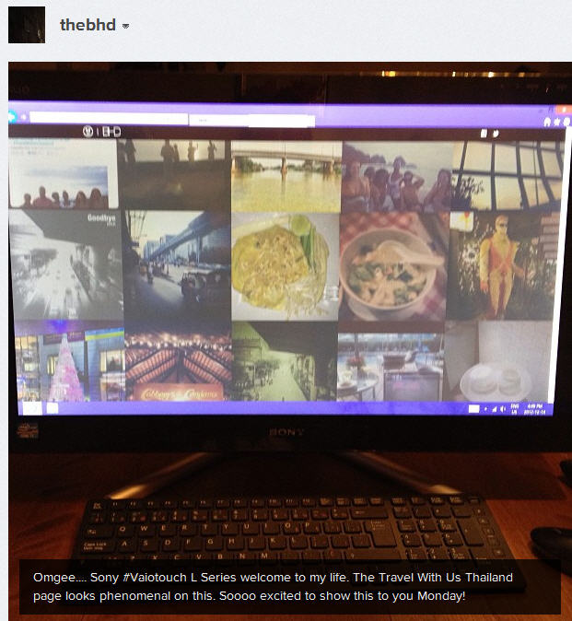
Review/Contest Stage of
VAIO Touch Influencer Campaign
VAIO Touch reviews and giveaways were facilitated on websites of 5 key influencers (Marcus Troy, BHD, DJ Lissa Monet, JAYSTRUT, and Bryan Espiritu).
Each blogger wrote product review with personalized photos of VAIO Touch user experience on their respective blog and tied it into their VAIO Touch contest – driving key product features.
Each contest included a Twitter component to ensure momentum of hashtag #VAIOTOUCH.
Influencer followers were
asked to comment
on each blog contest
page regarding how they
would use the particular
VAIO Touch model, for
a chance to win.

Slide 8
Influencer Contest Engagement
Tweets and facebook likes specifically refer to tweets/facebook posts DIRECTLY from the contest post on each blog.
Jay Strut, Fashion Blogger
391 tweets, 33 facebook likes, 17 Google+ likes, 89 contest entries & comments on contest post
Marcus Troy, Lifestyle Blogger/Brand Curator
109 tweets, 23 facebook likes, 5 instagram posts (256 likes), 94 contest entries and comments on contest post DJ Lissa Monet, Music/Entertainment Blogger
26 tweets, 20 facebook likes, 73 contest entries and comments on contest post
Bryan Espiritu, Artist/Designer
21 tweets, 16 instagram posts (1,434 likes), 40 contest entries and comments on contest post
Daniella Etienne, Broken Heel Diaries Blog Founder
Social Media Strategist/Brand Curator
12 tweets, 4 facebook likes, 9 instagram posts (150 likes) 69 contest entries and comments
on contest post

Slide 9
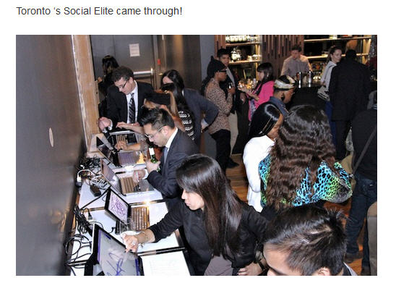
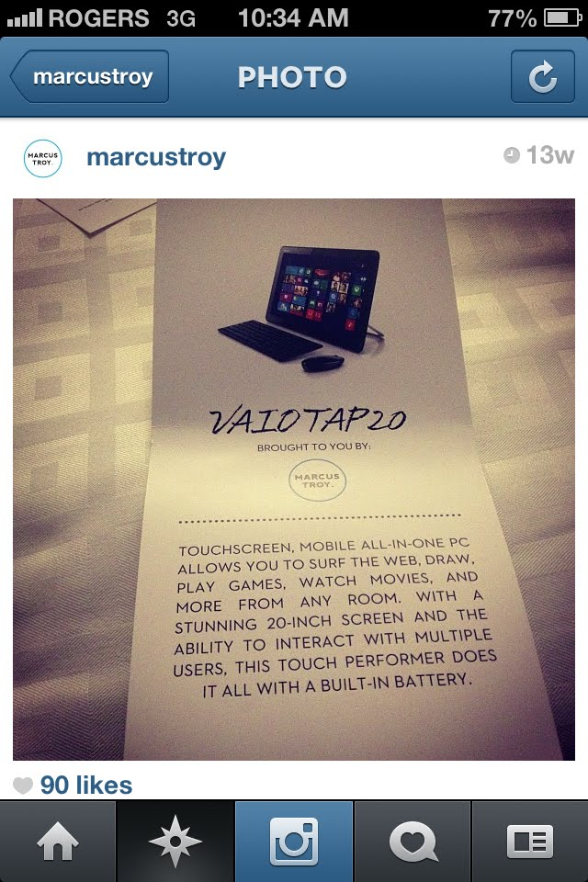
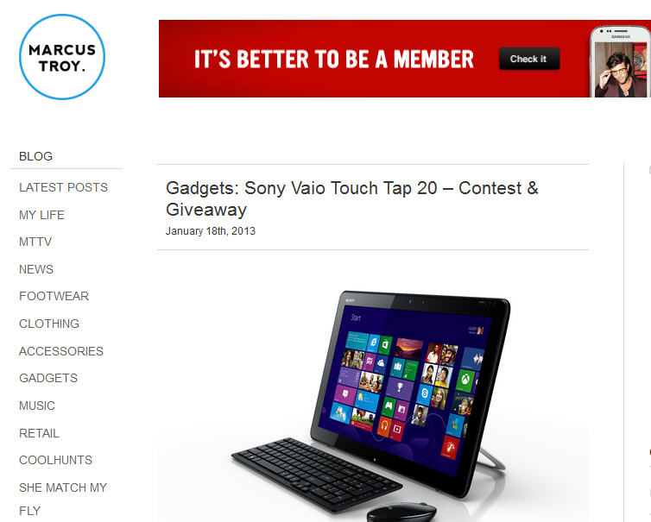
Marcustroy.com
280K total impressions (4 posts)
Twitter: ‏
@marcustroy
+10K impressions
@marcustroyblog
+5K impressions
Instagram:
+10K impressions

Slide 10
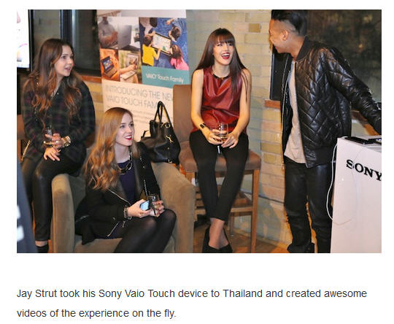
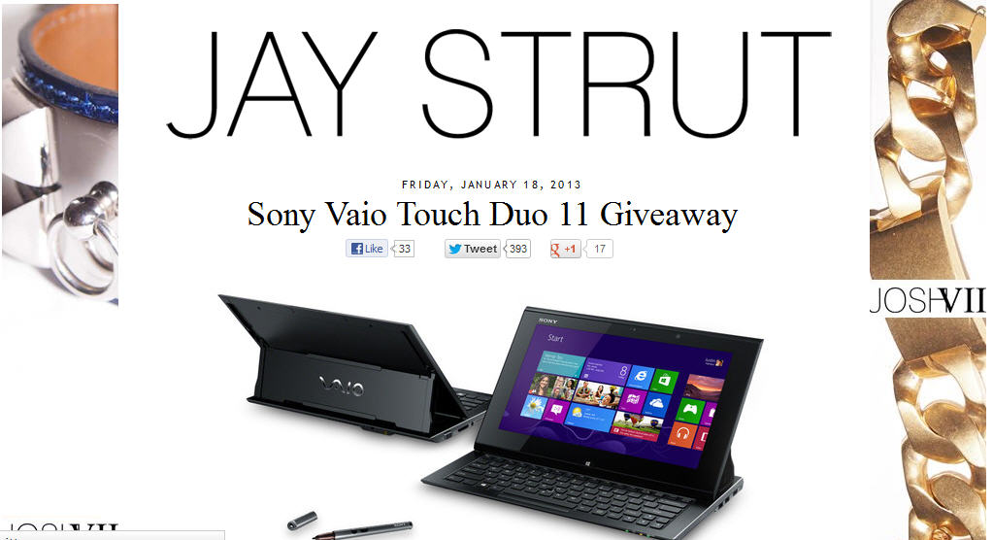
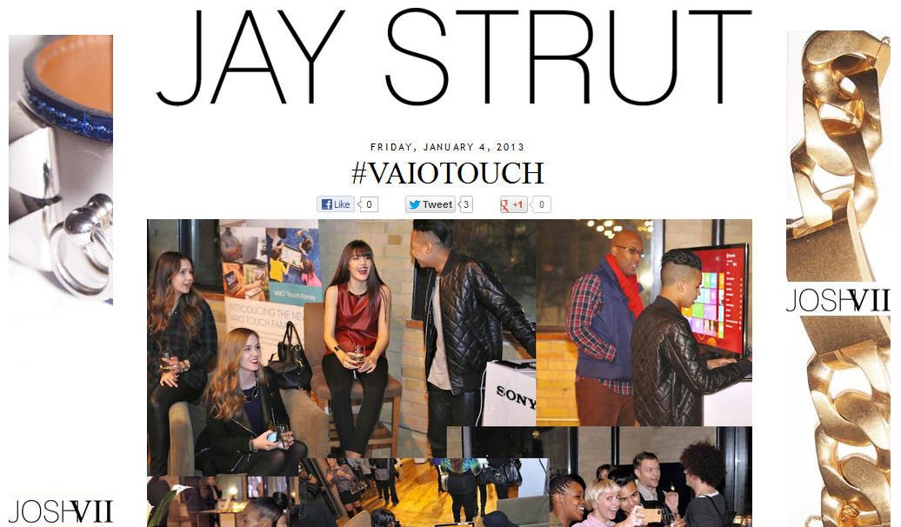
Jaystrut.com
222K total impressions
(5 posts)
Twitter:
+30K impressions
Instagram:
+15K impressions

Slide 11
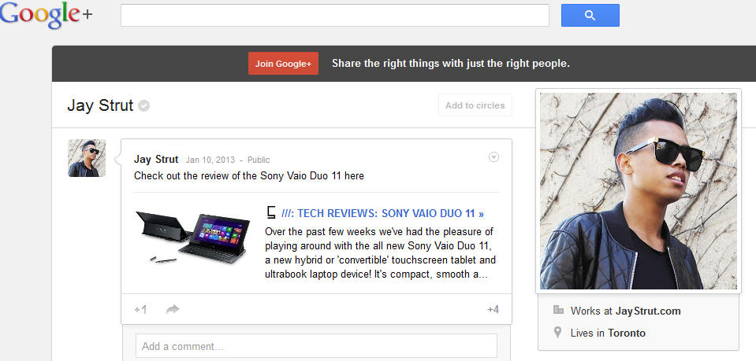

Slide 12
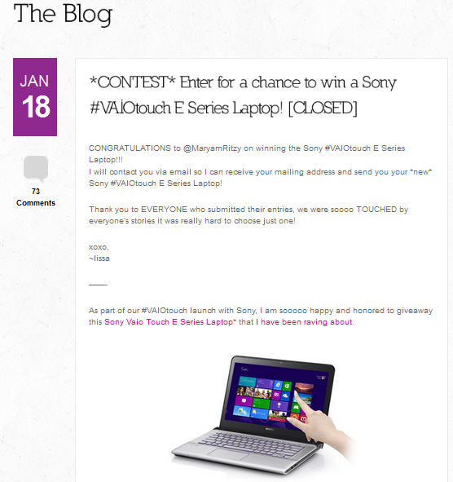
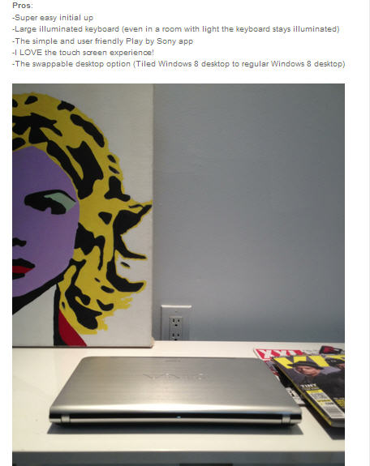
lissamonet.com
80K total impressions (4 posts)
Twitter: +8K impressions
Instagram: +3,600 impressions

Slide 13
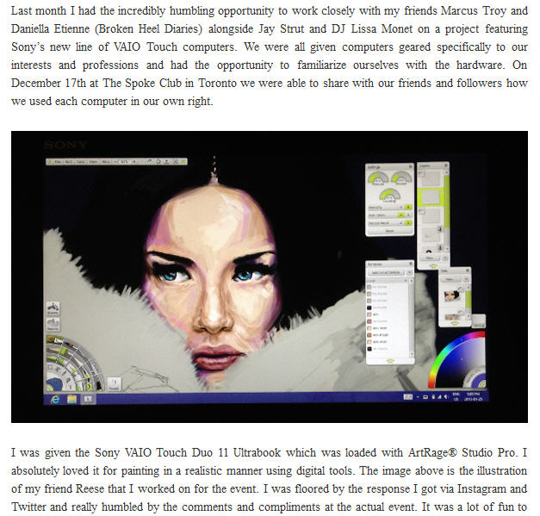
Bryan Espiritu, Artist/Designer
“Sony VAIO Touch Duo 11
Ultrabook was loaded with
ArtRage® Studio Pro.
I absolutely loved it for painting in a realistic manner using digital tools.
I was floored by the response I got via Instagram and Twitter.
I could see the excitement in people (at the event).”
store.thelegendsleague.com
+120K total impressions
(4 posts)
Twitter:
+4K impressions
Instagram:
+5K impressions

Slide 14
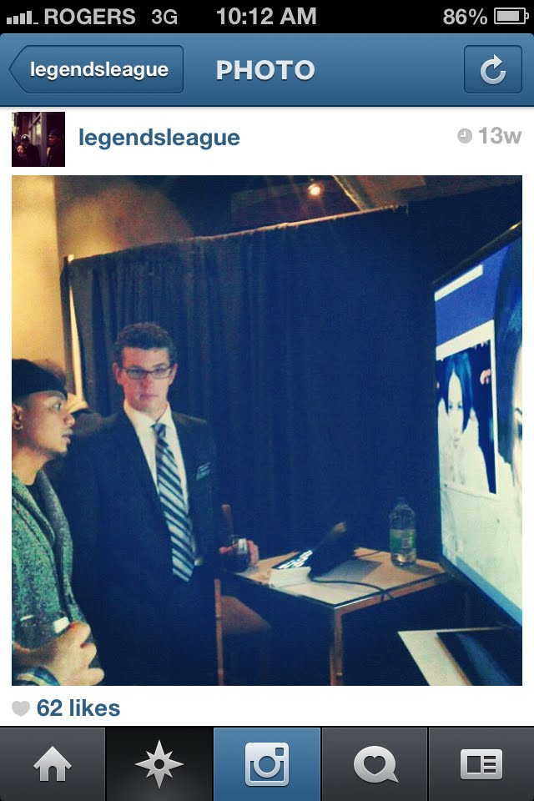
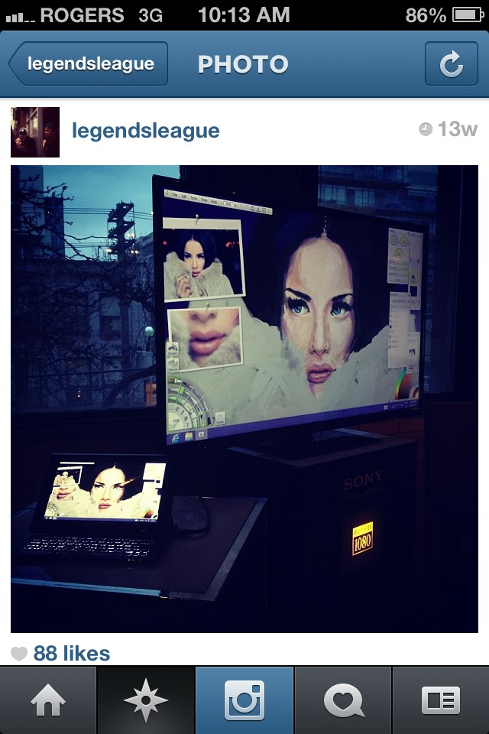
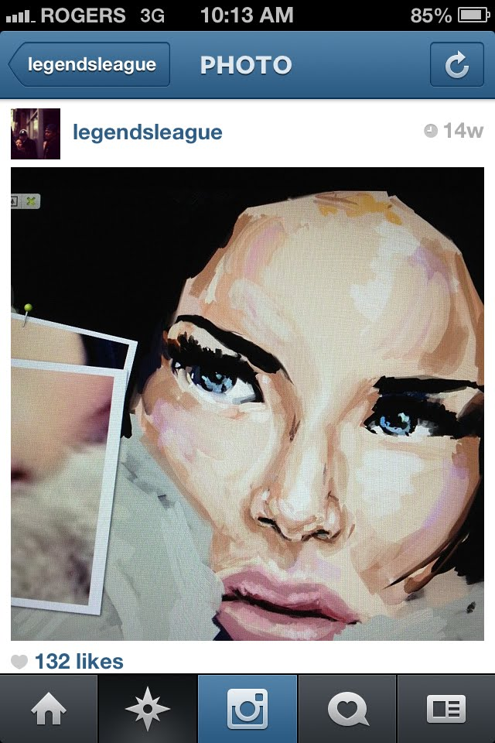
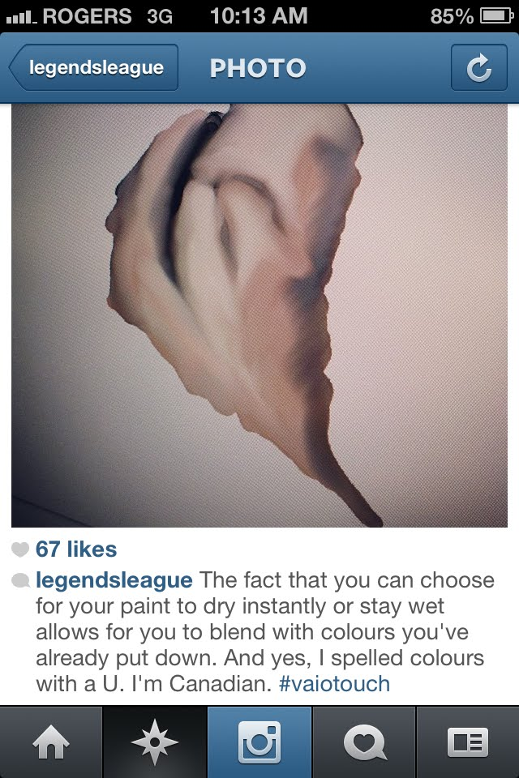
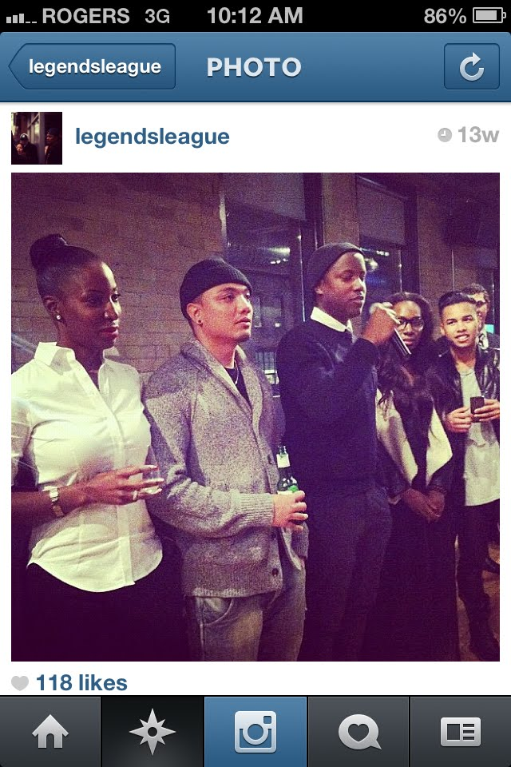
Bryan’s Instagram
1,434 VAIO-related likes

Slide 15
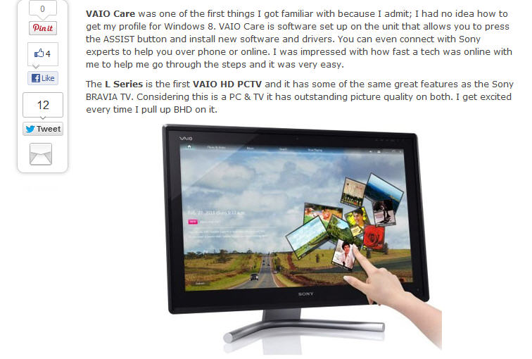
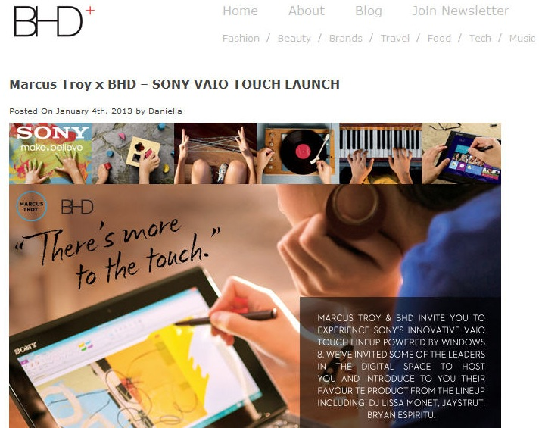
thebhd.com
25K total impressions
(4 posts)
Twitter:
+3K impressions
Instagram:
+1K impressions

Slide 16
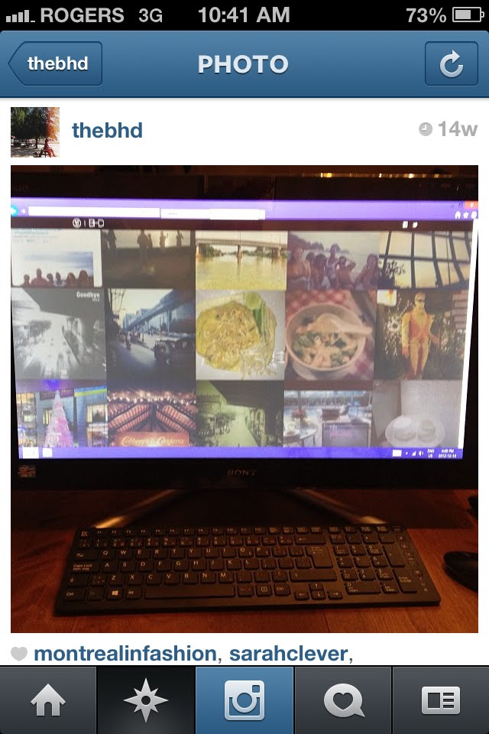
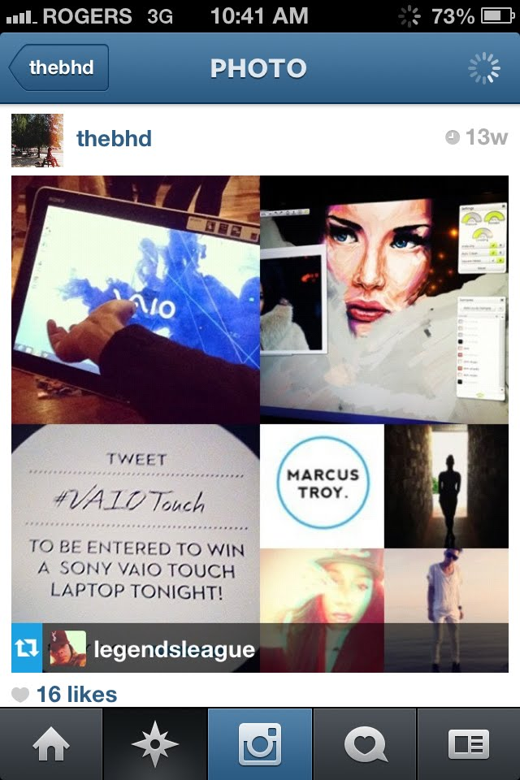
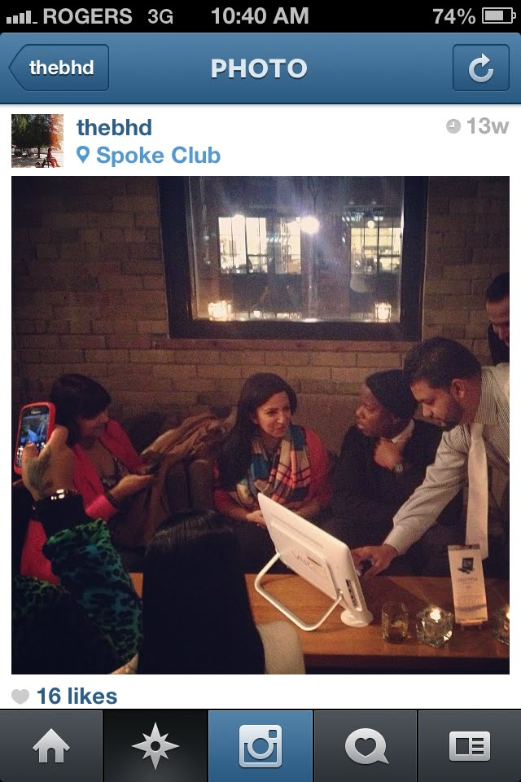
BHD’s Instagram
150 VAIO-related likes

